Slide 1
Making Inferences

Slide 2
An inference is…
What the text says
My thoughts - background knowledge
(Reading between the lines)

Slide 3
What do the pictures say?

Slide 4
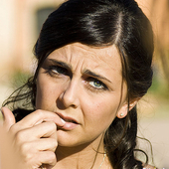

Slide 5
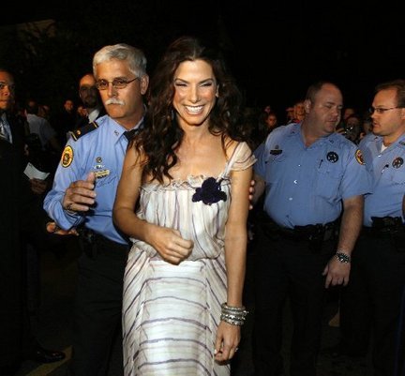

Slide 6
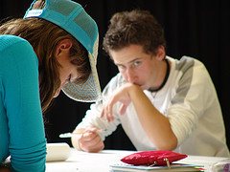

Slide 7
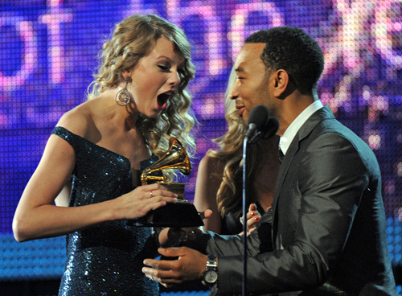

Slide 8
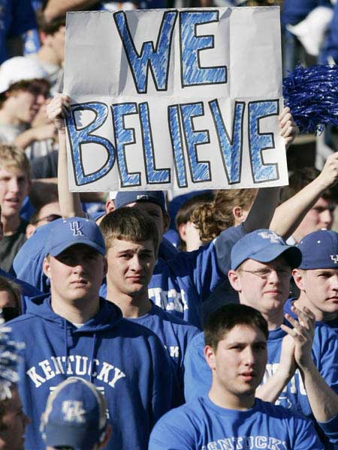

Slide 10
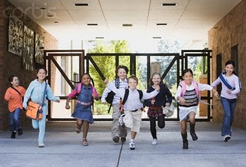

Slide 11
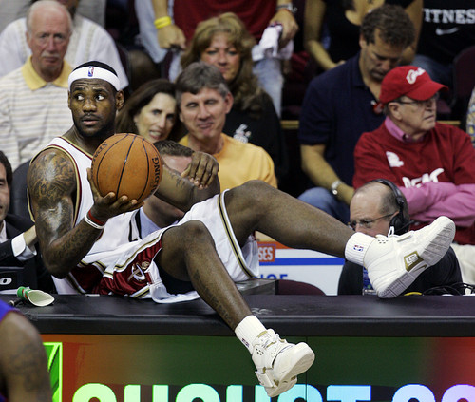

Slide 12
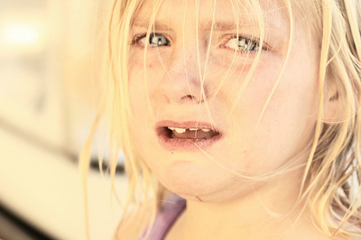

Slide 13
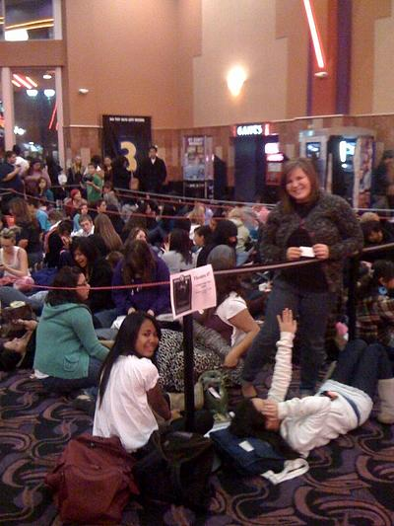

Slide 14
Now – What does the text say?
(Read between the lines)

Slide 15
Read each of these conversations and then answer the questions.
1) Sue: Look at the long line! Do you think we’ll get in?
Bob: I think so. Some of these people already have tickets.
Sue: How much are the tickets?
Bob: Only $4.50 for the first show. I’ll pay.
Sue: Thanks. I’ll buy some popcorn.
What are these people talking about?
Where are they?
Which words helped you guess?

Slide 16
2) Ann: Did you understand everything today?
Bill: No. I’m so confused.
Ann: So am I.
Bill: She doesn’t explain things very well. She goes too fast!
Ann: I know. And now we’re going to have a test!
What are these people talking about?
Where are they?
Which words helped you guess?

Slide 17
3) Abby: I can’t believe this is my last day here!
Dan: You’re leaving us today?
Abby: Yes. I’m so nervous about this.
Dan: I’m sure it will be fine.
Abby: I don’t know. It will be so different.
Dan: I thought you wanted a change.
Abby: Yes, I did. I wanted more pay. But now I’m not
sure it was the right thing to do.
Dan: Stop worrying. Everything will be fine.
What inferences can you make from this conversation?

Slide 18
It says… I say… So…
Use the Graphic Organizer and make at least four inferences for the following paragraph.
The young girl is standing on the corner. She is wearing a bright red jacket and bright red snow pants. She has a scarf tied around her face. She is wearing striped mittens. She looks to the left down the street. She stamps her feet. She puts her backpack on the ground. She looks to the left down the street again.

Slide 19
THE
END

